Slide 1
General announcements
This lab is listed as the Double Atwood Machine Lab (L-6) on the class Website. The picture on the next page shows you the set-up (you will note that it is not exactly as presented in the lab write-up—the set-up has been modified over the years for ease of execution). You will need to read the instructions explaining how to set up the computer, and what data to take (you will essentially be printing out a graph of the body’s position versus time graph, and its velocity versus time graph (with a regression line included for that second graph).

Slide 2
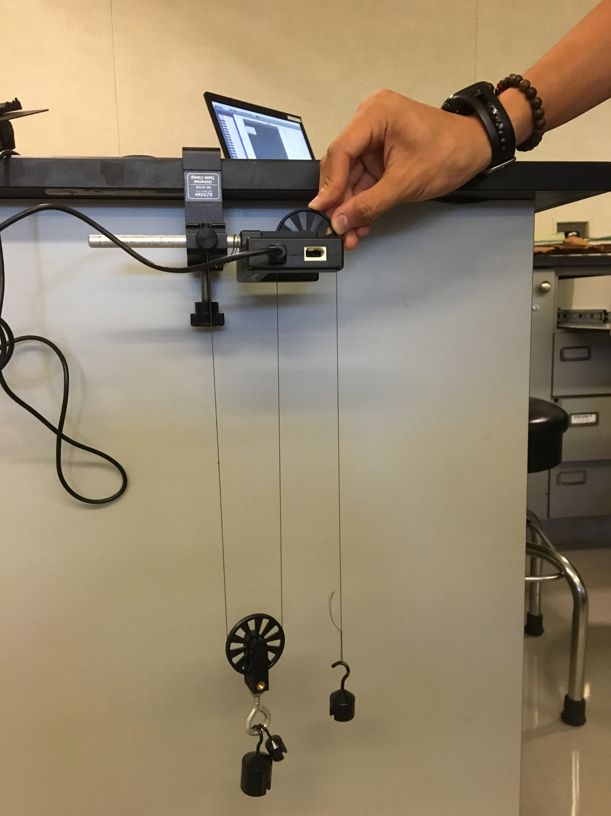
N2L lab pointers
Clamp the Smart Pulley on its side using a Pulley Clamp, with all strings hanging parallel and vertically (see sketch). Make the free-hanging mass 50.0 grams and the hanging pulley’s mass 100 grams (note that the actual mass value for the hanging system will be more as you’ll have to include the mass of the pulley). Attach the free end of the string to the Smart Pulley’s extension rod or the nut on the Pulley Clamp (whichever is most convenient).
note that all of these lines should be parallel

Slide 3
N2L lab pointers
Read the “hints for N2L lab” document in the lab’s folder on the class Web site (particularly the second page) before starting;
When finished, clean up. Please remember NOT to save your data on the computer. Put all equipment back IN THE SAME DRAWER you took it from.
--It gives ballpark accelerations for what you should see—if yours are significantly different from those, talk to me before breaking down your set-up!
Start working on the write-up:
--Draw FBDs;
--Sum forces in each direction for each object needed;
--Think about the relationship for acceleration and tension for each object

